Slide 1
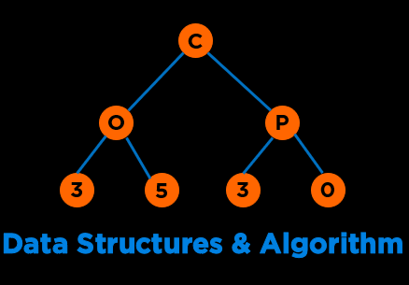
Algorithm Analysis
Notes:
Hi everyone, Welcome to the first module of this course. In this module we are going to discuss AA and CC.
We will talk about different mechanisms to evaluate performance of our programs

Slide 2


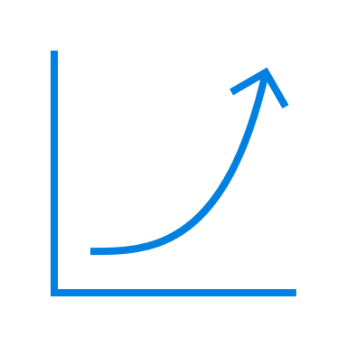
Agenda
What is an Algorithm?
Difference between a Program and an Algorithm
Multiple Ways of Solving a Problem
Benefits of Evaluating an Algorithm
How can we evaluate programs?
Approach 1 (Simulation: Timing)
Approach 2 (Modeling: Counting)
Approach 3 (Asymptotic Behavior: Order of Growth)
Notes:
Discussed, touched upon, went over, covered
Emerges out of the limitations offered by our second approach

Slide 3
Algorithm
Notes:
But before we get started let's discuss, What is an algorithm?

Slide 4
Algorithm
An algorithm is a step-by-step procedure for solving a problem.
Notes:
But before we get started let's discuss, What is an algorithm?

Slide 5



Algorithm
An algorithm is a step-by-step procedure for solving a problem.
Input
Output
Definite &
Unambiguous
Notes:
And lastly this behavior is rigid

Slide 6
Algorithm vs Program
 | Algorithm | Code or Program
Focus of a professional
Form
Dependence on H/W or OS
Professional’s Cognitive State
Correctness/Performance
Notes:
Again, thinking vs doing

Slide 7


Algorithm vs Program
 | Algorithm | Code or Program
Focus of a professional | Design | Implementation
Form | Pseudocode | Programming Language
Dependence on H/W or OS | No | Yes
Professional’s Cognitive State | Thinking | Doing
Correctness/Performance | Analysis | Testing
Notes:
Again, thinking vs doing

Slide 8
Multiple Ways of Solving a Problem
Notes:
So, you all have done a lot of programming in Prog 1 and 2
And everyone must agree that there are multiple ways of approaching the same problem
For example

Slide 9
Multiple Ways of Solving a Problem
Problem: Determine if a sorted array contains any duplicates.
-13 | -11 | 12 | 14 | 24 | 24 | 100 | 102
Notes:
We have this array

Slide 10
Multiple Ways of Solving a Problem
Problem: Determine if a sorted array contains any duplicates.
-13 | -11 | 12 | 14 | 24 | 24 | 100 | 102
Silly algorithm: Every possible pair
Notes:
And we design an algorithm comparing each pair

Slide 11
Multiple Ways of Solving a Problem
Problem: Determine if a sorted array contains any duplicates.
-13 | -11 | 12 | 14 | 24 | 24 | 100 | 102
Silly algorithm: Every possible pair
Better algorithm: Compare adjacents
https://onlinegdb.com/SHYJzMAxD
Notes:
Array 4;
Naive , naivish, efficient: 16 (n^2-n), 6 (n^2-n/2), 3 (n-1)

Slide 12
Multiple Ways of Solving a Problem
Problem: Determine if a sorted array contains any duplicates.
-13 | -11 | 12 | 14 | 24 | 24 | 100 | 102
Silly algorithm: Every possible pair
Better algorithm: Compare adjacents
Now that we know, that there are multiple ways to solve a problem, how do we evaluate which one is better?
Notes:
But a fundamental question to ask is are all programs/algorithms equal in terms of performance?
We definitely know that Algo 2 is way better than
But how can we formalize this more rigorously

Slide 13
Are all programs/algorithms equal in terms of performance?
Notes:
And since we all are computer scientists we need to think deeper about this word performance
Performance in terms of what?

Slide 14
Performance
In terms of what?
Are all programs/algorithms equal in terms of performance?
Notes:
Performance in terms of what?

Slide 15
Performance
In terms of what?
Time
Space
Are all programs/algorithms equal in terms of performance?
Notes:
In terms of time and space a little bit more on time as the space gets cheaper due to moore’s law
Also, there is also a tradeoff

Slide 16
Why do we care about algorithms?
Notes:
Again for the places you work at it may be the cost to store data, or to acquire customers

Slide 17




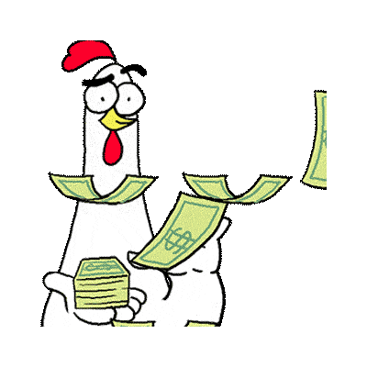
Why do we care about algorithms?
Knowing
Experiencing
Selling
Cost
Notes:
Again for the places you work at it may be the cost to store data, or to acquire customers

Slide 18

A Simple Example
Notes:
So let's see a quick example. I requested my data from Google

Slide 19
A Simple Example
Google has 2 billion active users
Conservative estimate ~ 1 GB of data/user
Total Data (Space):
Notes:
Google has roughly

Slide 20
A Simple Example
Google has 2 billion active users
Conservative estimate ~ 1 GB of data/user
Total Data (Space): 2 Exabytes
Total Time:
Notes:
Or 2 million terabytes/ exabytes
What about time to look for information for a simple search algorithm

Slide 21
A Simple Example
Google has 2 billion active users
Conservative estimate ~ 1 GB of data/user
Total Data (Space): 2 Exabytes
Total Time:
Operation Speed: 0.5 ns
Linear Search
Binary Search
Notes:
For that we need to know the processor speed

Slide 22
A Simple Example
Google has 2 billion active users
Conservative estimate ~ 1 GB of data/user
Total Data (Space): 2 Exabytes
Total Time:
Operation Speed: 0.5 ns
Linear Search: 11574 days or 31 years
Binary Search: 31s
Notes:
2*10^9 * 10^9 * 0.5 * 10^-9

Slide 23
In short, we care about performance …
So, how do we measure performance?
Notes:
And since we all are computer scientists we need to think deeper about this word performance
Performance in terms of what?

Slide 24
Questions to ask when evaluating programs
Time: How much time does this take?
Space: How much space does this consume?
Data: Are there any patterns in our data?
Notes:
And in all these three approaches we have to ask these three questions

Slide 25
Approach 1 (Simulation: Timing)
Notes:
In this video we will discuss three approaches to evaluate program performance. We are going to discuss two today and one during the next lecture
Measure execution time using a stopwatch

Slide 26
Approach 1 (Simulation: Timing)
Code #1
Code #2
01 02 03 04
auto t1 = Clock::now(); for(int i=0; i<1000; i++); auto t2 = Clock::now(); Print t2-t1
01 02 03 04
auto t1 = Clock::now(); for(int i=0; i<1000000; i++); auto t2 = Clock::now(); Print t2-t1
Notes:
The first approach is simple, you

Slide 27
Approach 1 (Simulation: Timing)
Code #1
Code #2
01 02 03 04
auto t1 = Clock::now(); for(int i=0; i<1000; i++); auto t2 = Clock::now(); Print t2-t1
01 02 03 04
auto t1 = Clock::now(); for(int i=0; i<1000000; i++); auto t2 = Clock::now(); Print t2-t1
Output
Delta t = t2-t1 (1000): 2910 nanoseconds
Delta t = t2-t1 (10000): 27240 nanoseconds
Delta t = t2-t1 (100000): 323090 nanoseconds
Delta t = t2-t1 (1000000): 2761565 nanoseconds
https://onlinegdb.com/BJGAP7I5I
Notes:
In this video we will discuss three approaches to evaluate program performance

Slide 28
Approach 1 (Simulation: Timing)
Pros | Cons
Notes:
So let's discuss the pros and cons of this approach

Slide 29
Approach 1 (Simulation: Timing)
Pros | Cons
Easy to measure | Results vary across machines
Easy to interpret | Compiler dependent
 | Results vary across implementations
 | Not predictable for small inputs
 | No clear relationship between input and time
Notes:
So let's discuss the pros and cons of this approach

Slide 30
Approach 2 (Modeling: Counting)
Notes:
That brings us to the second approach

Slide 31
Approach 2 (Modeling: Counting)
Count the number of operations
Notes:
What if we count the number of operations

Slide 32
Approach 2 (Modeling: Counting)
Count the number of operations
01 02 03 04
int sum=0; for(int i=0; i<n; i++) sum += i; print sum
Operation | Symbolic count
int sum=0;
int i=0;
i<n;
i++
sum += i;
print sum
T(n)
Notes:
But what do we truly care about?

Slide 33
Approach 2 (Modeling: Counting)
Count the number of operations
01 02 03 04
int sum=0; for(int i=0; i<n; i++) sum += i; print sum
Operation | Symbolic count
int sum=0; | 1
int i=0; | 1
i<n; | 0…n = n+1
i++ | n
sum += i; | n
print sum | 1
T(n) | 3n+4
Notes:
But what do we truly care about?

Slide 34
Approach 2 (Modeling: Counting)
Pros | Cons
 | No definition of which op to count
 | Tedious to compute
 | Results vary across implementations
 | Doesn’t tell you actual time
Notes:
But what do we truly care about?

Slide 35
Approach 2 (Modeling: Counting)
Pros | Cons
Independent of computer | All operations are equal
Input dependence is captured in model (Scaling) | Tedious to compute
 | Results vary across implementations
 | Doesn’t tell you actual time
Notes:
But what do we truly care about?

Slide 36

Approach 2 (Modeling: Counting)
Count the number of operations
01 02 03 04
int sum=0; for(int i=0; i<n; i++) sum += i; print sum
Tedious to compute:
Different variables, so many operations, so many equations!
Operation | Symbolic count
int sum=0; | 1
int i=0; | 1
i<n; | 0…n = n+1
i++ | n
sum += i; | n
print sum | 1
T(n) | 3n+4
Notes:
The issues with this approach was
Think about what matters most how functions are growing

Slide 37
Approach 2 (Modeling: Counting)
Count the number of operations
01 02 03 04
int sum=0; for(int i=0; i<n; i++) sum += i; print sum
Tedious to compute:
Different variables, so many operations, so many equations!
Operation | Symbolic count
int sum=0; | 1
int i=0; | 1
i<n; | 0…n = n+1
i++ | n
sum += i; | n
print sum | 1
T(n) | 3n+4
Can we eliminate the complexity or get rid of extraneous variables?
Notes:
The issues with this approach was
Think about what matters most how functions are growing

Slide 38
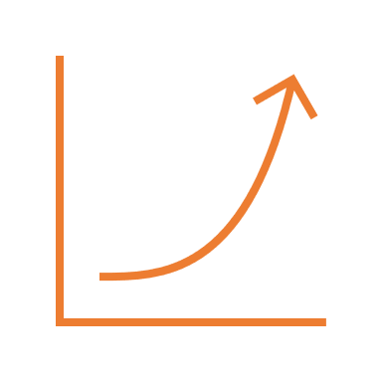
Approach 3 (Asymptotic Behavior: Order of Growth)
Notes:
Higher abstraction

Slide 39
Which variables should we eliminate?
Operation | Symbolic count
int sum=0; | 1
int i=0; | 1
i<n; | 0…n = n+1
i++ | n
sum += i; | n
print sum | 1
T(n) | 3n+4
Notes:
The issues with this approach was
Think about what matters most how functions are growing

Slide 40
Growth of Functions
Time, y = T(n)
 | 1 | log n | n | n log n | n² | n³ | 2^{n} | n!
1
10
100
1000
10000
100000
1000000
10000000
100000000
Inputs: n
Notes:
But one key takeaway from such complex equations is that when you are analyisng a program,
A lot of variables can be eliminated because of the nature of functions

Slide 41
Growth of Functions
Time, y = T(n)
 | 1 | log n | n | n log n | n² | n³ | 2^{n} | n!
1 | 1
10 | 1
100 | 1
1000 | 1
10000 | 1
100000 | 1
1000000 | 1
10000000 | 1
100000000 | 1
Inputs: n
Notes:
But one key takeaway from such complex equations is that when you are analyisng a program,
A lot of variables can be eliminated because of the nature of functions

Slide 42
Growth of Functions
Time, y = T(n)
 | 1 | log n | n | n log n | n² | n³ | 2^{n} | n!
1 | 1 | 0
10 | 1 | 3
100 | 1 | 7
1000 | 1 | 10
10000 | 1 | 13
100000 | 1 | 17
1000000 | 1 | 20
10000000 | 1 | 23
100000000 | 1 | 27
Inputs: n
Notes:
But one key takeaway from such complex equations is that when you are analyisng a program,
A lot of variables can be eliminated because of the nature of functions

Slide 43
Growth of Functions
Time, y = T(n)
 | 1 | log n | n | n log n | n² | n³ | 2^{n} | n!
1 | 1 | 0 | 1 | 0 | 1 | 1 | 2 | 1
10 | 1 | 3 | 10 | 30 | 100 | 1000 | 1024 | 3628800
100 | 1 | 7 | 100 | 700 | 10000 | 1000000 | 1.26765E+30 | 9.3326E+157
1000 | 1 | 10 | 1000 | 10000 | 1000000 | 1000000000 | 1.0715E+301 | #NUM!
10000 | 1 | 13 | 10000 | 130000 | 100000000 | 1E+12 | #NUM! | #NUM!
100000 | 1 | 17 | 100000 | 1700000 | 10000000000 | 1E+15 | #NUM! | #NUM!
1000000 | 1 | 20 | 1000000 | 20000000 | 1E+12 | 1E+18 | #NUM! | #NUM!
10000000 | 1 | 23 | 10000000 | 230000000 | 1E+14 | 1E+21 | #NUM! | #NUM!
100000000 | 1 | 27 | 100000000 | 2700000000 | 1E+16 | 1E+24 | #NUM! | #NUM!
Inputs: n
Order of Growth gets Faster or Functions rise faster
Notes:
But one key takeaway from such complex equations is that when you are analyisng a program,
A lot of variables can be eliminated because of the nature of functions

Slide 44


Eliminate functions that grow
slower
Notes:
But one key takeaway from such complex equations is that when you are analyisng a program,
A lot of variables can be eliminated because of the nature of functions

Slide 45
Approach 3 (Asymptotic Behavior: Order of Growth)
Very Large N
Notes:
Higher abstraction

Slide 46
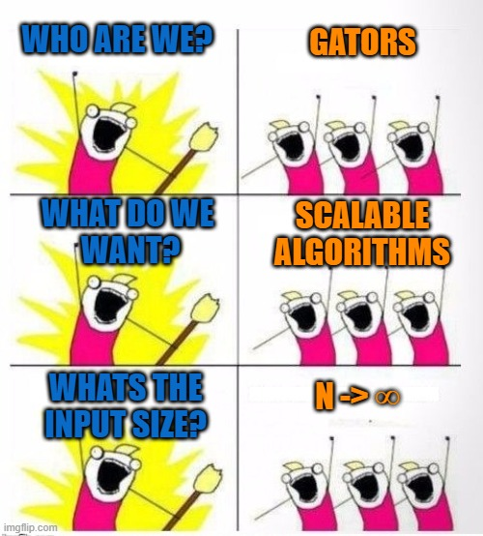
Approach 3 (Asymptotic Behavior: Order of Growth)
Very Large N
https://imgflip.com/i/3z0jdf
Notes:
Higher abstraction

Slide 47
Notations for Algorithm Complexity
Time - Number of Operations:
Big-O : Upper Bound
Big-Ω : Lower Bound
Big-Θ : Upper + Lower Bound
Notes:
There are three main notations to describe Algo complexity in terms of the number of operations. We only care about upperbound
A mathematical tool to map the complexity of programs

Slide 48
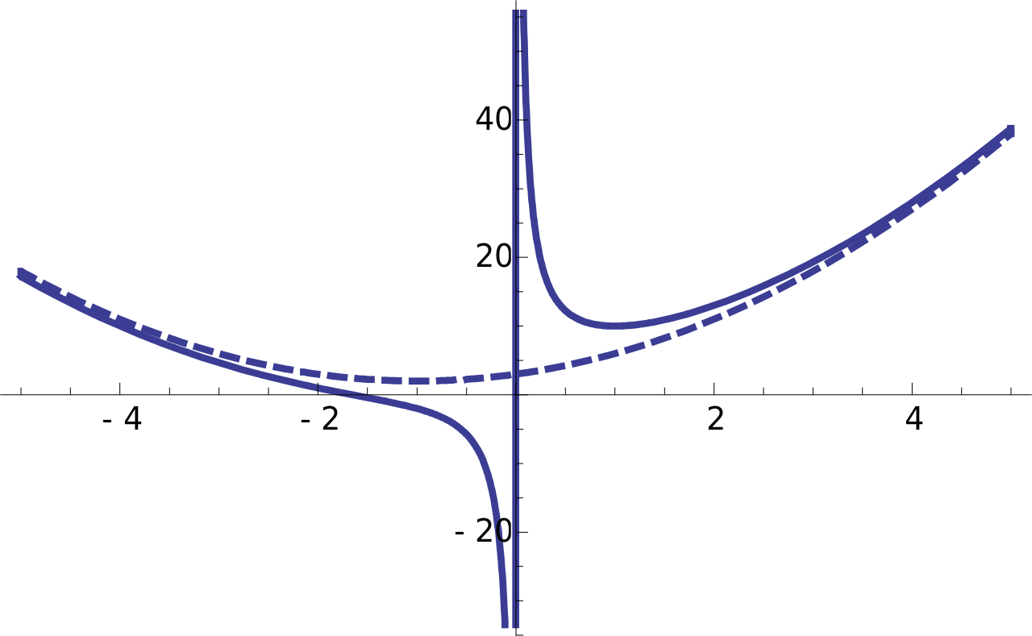
Asymptotic Bounding
Line that approaches a curve but never meets
Analysis of tail behavior
N -> Infinity
This Photo by Unknown Author is licensed under CC BY-SA

Slide 49
Big O (Visualize)
T(n) $∈$ O(f(n))
If there exists two positive constants, n₀ and c, such that T(n) $≤$ c.f(n) for all n $≥$ n₀
f(n) is an upper bound on performance
T(n) will grow no faster than constant times f(n)
Use tighter upper bound
Notes:
T n is big o of Fn; Big O is a set of functions
For all n > n0 , the graph of cf(n) falls above the graph of T(n)
as n gets sufficiently large (larger than n₀), there is some constant c for which the processing time will always be less than or equal to cf(n)
We define a function T(n) as being “Big-O of” or “on the order of” f(n) if there exist two constants, no and c, such that for all n>no, c times f(n) is greater than T(n)
As n gets sufficiently large, we can find a constant such that c times f(n) is an upper bound on performance.

Slide 50
Big Ω
T(n) $∈$ Ω(g(n))
If there exists two positive constants, n₀ and c, such that T(n) $≥$ c.g(n) for all n $≥$ n₀
g(n) is a lower bound on growth rate of T(n)
T(n) will grow no slower than constant times g(n)
Use tighter lower bound
Notes:
For all n > n0 , the graph of cg(n) falls below the graph of T(n)
2n 3n+5, 4n, n>=5

Slide 51
Big Θ
T(n) $∈$ Θ(g(n))
If T(n) = O(g(n)) and T(n) = Ω(g(n))
c₁.g(n) $≤$ T(n) $≤$ c₂.g(n) for all n $≥$ n₀
g(n) is a tight upper and lower bound on the growth rate of T(n)
Notes:
Fn is theta n, drop “is-in”

Slide 52
Big Θ vs Big O vs Big Ω
 | Informal meaning: | Family | Family Members, T(n)
Big Theta Θ(f(N)) | Order of growth is f(N). | Θ(N²) | N²/12 2N² N² + 11N
Big O O(f(N)) | Order of growth is less than or equal to f(N). | O(N²) | N²/2 N² + 1 lg(N)
Big Ω Ω(f(N))
Source: https://sp19.datastructur.es/index.html
Notes:
Fn is theta n, drop “is-in”

Slide 53
Constant Growth Rate, O(1)
If processing time is independent of the number of inputs n, the algorithm grows at a constant rate
01 02 03 04 05 06 07
int sum(int n) { int sum = 0; sum += n; return sum; }
n | y = f(c)
1 | 3
10 | 3
100 | 3
1000 | 3
10000 | 3
100000 | 3
1000000 | 3
10000000 | 3
100000000 | 3
T(n) = 3, T(n) $∈$ O(1)
Notes:
The function calculates sume of numbers from 1- n

Slide 54
Linear Growth Rate
If processing time increases in proportion to the number of inputs n, the algorithm grows at a linear rate
01 02 03 04 05 06 07
int sum(int n) { int sum = 0; for (int i=0; i<n; i++) sum += i+1; return sum; }
n | y = f(n)
1 | 1
10 | 10
100 | 100
1000 | 1000
10000 | 10000
100000 | 100000
1000000 | 1000000
10000000 | 10000000
100000000 | 100000000
T(n) = 3n + 4, T(n) $∈$ O(n), c=4, n₀>4
Notes:
https://www.transum.org/Maths/Activity/Graph/Desmos.asp

Slide 55
Quadratic Growth Rate
If processing time increases in proportion to the square of input size n, the algorithm grows at a quadratic rate
01 02 03 04 05 06 07 08 09
bool find(int n[][], int t) { int i, j; for(i=0; i < n.size; i++) for(j=0; j < n.size; j++) if (x[i][j] == t) return true; return false; }
n | y = f(n²)
1 | 1
10 | 100
100 | 10000
1000 | 1000000
10000 | 100000000
100000 | 10000000000
1000000 | 1E+12
10000000 | 1E+14
100000000 | 1E+16
T(n) = n² + 3n + 5, T(n) $∈$ O(n²), c=?, n₀>?
Notes:
The function calculates sume of numbers from 1- n

Slide 56
Logarithmic Growth Rate
If processing time increases in proportion to the log n, the algorithm grows at a logarithmic rate
01 02 03 04 05 06 07
int sum(int n) { int sum = 0; for (int i=1; i<=n; i*=2) sum += i; return sum; }
n | y = f(log₂n)
1 | 0
10 | 3
100 | 7
1000 | 10
10000 | 13
100000 | 17
1000000 | 20
10000000 | 23
100000000 | 27
Notes:
The loop body will execute k times, with i having the following values: 1, 2, 4, 8, 16, . . ., 2^{k-1}
We know that 2^{k-1} <= n
We know that k = log n
So the number of times that the loop executes is proportional to log(n)
This is O(log n). (Write this on the slide.)
In computer science we take logarithms in base 2. Because machine language is based on binary digits
Think of log base 2 as the number of times that you can divide a number by 2 before the value is less than 1.
When determining the computational complexity of code, if you see items being multiplied or divided, start thinking about whether it’s logarithmic

Slide 57
Logarithmic Growth Rate
If processing time increases in proportion to the log n, the algorithm grows at a logarithmic rate
01 02 03 04 05 06 07
int sum(int n) { int sum = 0; for (int i=1; i<=n; i*=2) sum += i; return sum; }
n | y = f(log₂n)
1 | 0
10 | 3
100 | 7
1000 | 10
10000 | 13
100000 | 17
1000000 | 20
10000000 | 23
100000000 | 27
n | 1 | 2 | 4 | 8 | 16 | . | . | . | ?
n (in powers of two) | 2⁰ | 2¹ | 2² | 2³ | 2⁴ | . | . | . | ?
# of times the loop executes | 1 | 2 | 3 | 4 | 5 | . | . | . | k
Notes:
The loop body will execute k times, with i having the following values: 1, 2, 4, 8, 16, . . ., 2^{k-1}
We know that 2^{k-1} <= n
We know that k = log n
So the number of times that the loop executes is proportional to log(n)
This is O(log n). (Write this on the slide.)
In computer science we take logarithms in base 2. Because machine language is based on binary digits
Think of log base 2 as the number of times that you can divide a number by 2 before the value is less than 1.
When determining the computational complexity of code, if you see items being multiplied or divided, start thinking about whether it’s logarithmic

Slide 58
Logarithmic Growth Rate
If processing time increases in proportion to the log n, the algorithm grows at a logarithmic rate
01 02 03 04 05 06 07
int sum(int n) { int sum = 0; for (int i=1; i<=n; i*=2) sum += i; return sum; }
n | y = f(log₂n)
1 | 0
10 | 3
100 | 7
1000 | 10
10000 | 13
100000 | 17
1000000 | 20
10000000 | 23
100000000 | 27
n | 1 | 2 | 4 | 8 | 16 | . | . | . | 2^{k-1}
n (in powers of two) | 2⁰ | 2¹ | 2² | 2³ | 2⁴ | . | . | . | 2^{k-1}
# of times the loop executes | 1 | 2 | 3 | 4 | 5 | . | . | . | k
Notes:
The loop body will execute k times, with i having the following values: 1, 2, 4, 8, 16, . . ., 2^{k-1}
We know that 2^{k-1} <= n
We know that k = log n
So the number of times that the loop executes is proportional to log(n)
This is O(log n). (Write this on the slide.)
In computer science we take logarithms in base 2. Because machine language is based on binary digits
Think of log base 2 as the number of times that you can divide a number by 2 before the value is less than 1.
When determining the computational complexity of code, if you see items being multiplied or divided, start thinking about whether it’s logarithmic

Slide 59
Logarithmic Growth Rate
If processing time increases in proportion to the log n, the algorithm grows at a logarithmic rate
01 02 03 04 05 06 07
int sum(int n) { int sum = 0; for (int i=1; i<=n; i*=2) sum += i; return sum; }
n | y = f(log₂n)
1 | 0
10 | 3
100 | 7
1000 | 10
10000 | 13
100000 | 17
1000000 | 20
10000000 | 23
100000000 | 27
n | 1 | 2 | 4 | 8 | 16 | . | . | . | 2^{k-1}
n (in powers of two) | 2⁰ | 2¹ | 2² | 2³ | 2⁴ | . | . | . | 2^{k-1}
# of times the loop executes | 1 | 2 | 3 | 4 | 5 | . | . | . | k
We know that 2^{k-1} <= n; k <= (log₂ n + 1); k ∝ log₂ n;
Notes:
The loop body will execute k times, with i having the following values: 1, 2, 4, 8, 16, . . ., 2^{k-1}
We know that 2^{k-1} <= n
We know that k = log n
So the number of times that the loop executes is proportional to log(n)
This is O(log n). (Write this on the slide.)
In computer science we take logarithms in base 2. Because machine language is based on binary digits
Think of log base 2 as the number of times that you can divide a number by 2 before the value is less than 1.
When determining the computational complexity of code, if you see items being multiplied or divided, start thinking about whether it’s logarithmic

Slide 60
Different Growth Rates
Time
 | O(1) | O(log n) | O(n) | O(n log n) | O(n²) | O(n³) | O(2^{n}) | O(n!)
1 | 1 | 0 | 1 | 0 | 1 | 1 | 2 | 1
10 | 1 | 3 | 10 | 10 | 100 | 1000 | 1024 | 3628800
100 | 1 | 7 | 100 | 200 | 10000 | 1000000 | 1.26765E+30 | 9.3326E+157
1000 | 1 | 10 | 1000 | 3000 | 1000000 | 1000000000 | 1.0715E+301 | #NUM!
10000 | 1 | 13 | 10000 | 40000 | 100000000 | 1E+12 | #NUM! | #NUM!
100000 | 1 | 17 | 100000 | 500000 | 10000000000 | 1E+15 | #NUM! | #NUM!
1000000 | 1 | 20 | 1000000 | 6000000 | 1E+12 | 1E+18 | #NUM! | #NUM!
10000000 | 1 | 23 | 10000000 | 70000000 | 1E+14 | 1E+21 | #NUM! | #NUM!
100000000 | 1 | 27 | 100000000 | 800000000 | 1E+16 | 1E+24 | #NUM! | #NUM!
Inputs: n
Order of Growth gets Faster, Complexity increases
Constant < Logarithmic < Linear < Loglinear < Polynomial < Exponential < Factorial
Notes:
But what do we truly care about?

Slide 61
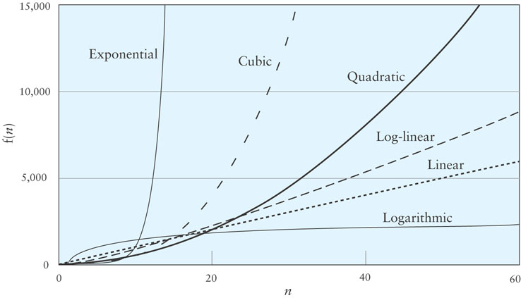
Different Growth Rates
http://bigocheatsheet.com/
Notes:
But what do we truly care about?

Slide 62
Tips for Asymptotic Analysis (Big O)
Notes:
But what do we truly care about?

Slide 63
Tip #1: Addition (Independence)
void func1(int n, int m)
{
for (int i = 0; i < n; i++)
cout << i;
for (int j = 0; j < m; j++)
cout << j;
}

Slide 64

Tip #1: Addition (Independence)
void func1(int n, int m)
{
for (int i = 0; i < n; i++)
cout << i;
for (int j = 0; j < m; j++)
cout << j;
}
https://www.loom.com/share/336adfe079264fdfaf32726b45eec8cf
T(n, m) $∈$ O(n+m)

Slide 65
Tip #2: Drop Constant Multipliers
void func2(int n)
{
for (int i = 0; i < n; i++)
cout << i;
for (int j = 0; j < n; j++)
cout << j;
}
https://www.loom.com/share/336adfe079264fdfaf32726b45eec8cf

Slide 66
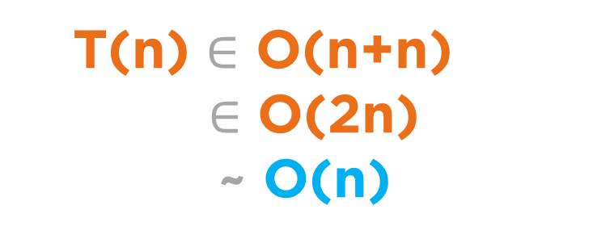
Tip #2: Drop Constant Multipliers
void func2(int n)
{
for (int i = 0; i < n; i++)
cout << i;
for (int j = 0; j < n; j++)
cout << j;
}
https://www.loom.com/share/336adfe079264fdfaf32726b45eec8cf
T(n) $∈$ O(n+n)
$∈$ O(2n)
~ O(n)

Slide 67
Tip #3: Different Input Variables
void func3(int x, int y)
{
for (int i = 0; i < x; i++)
cout << i;
for (int j = 0; j < y; j++)
cout << j;
}
https://www.loom.com/share/336adfe079264fdfaf32726b45eec8cf

Slide 68

Tip #3: Different Input Variables
void func3(int x, int y)
{
for (int i = 0; i < x; i++)
cout << i;
for (int j = 0; j < y; j++)
cout << j;
}
https://www.loom.com/share/336adfe079264fdfaf32726b45eec8cf
T(x, y) $∈$ O(x+y)
Describe what the variable is, Always!
Example: O(x) where x is the size or length of a string

Slide 69
Tip #4a: Drop Lower Order Terms with Similar Growth Rates
void func4a(int n)
{
for (int i = 0; i < n; i++)
cout << i;
for (int j = 1; j < n; j*=2)
cout << j;
}
https://www.loom.com/share/336adfe079264fdfaf32726b45eec8cf

Slide 70
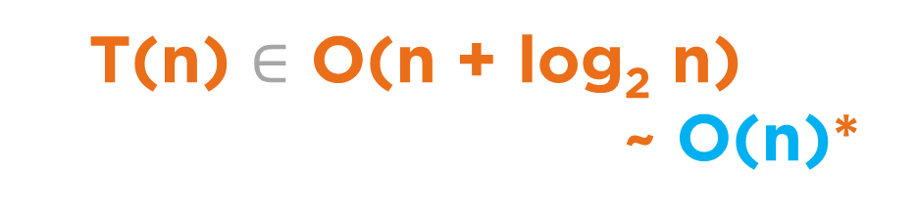
Tip #4a: Drop Lower Order Terms with Similar Growth Rates
void func4a(int n)
{
for (int i = 0; i < n; i++)
cout << i;
for (int j = 1; j < n; j*=2)
cout << j;
}
https://www.loom.com/share/336adfe079264fdfaf32726b45eec8cf
T(n) $∈$ O(n + log₂ n)
~ O(n)*
*Both variables are n and grow at the same rate.

Slide 71
Tip #4b: Drop Lower Order Terms with Similar Growth Rates
void func4b(int n, int m)
{
for (int i = 0; i < n; i++)
cout << i;
for (int j = 1; j < m; j*=2)
cout << j;
}
https://www.loom.com/share/336adfe079264fdfaf32726b45eec8cf

Slide 72
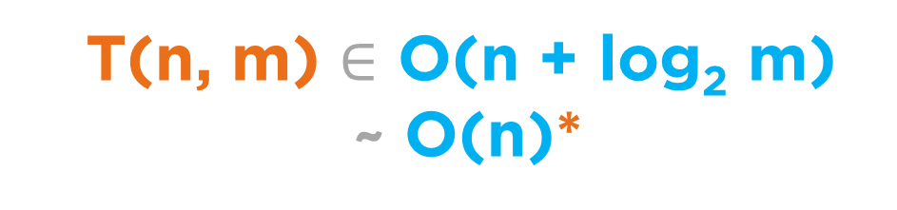
Tip #4b: Drop Lower Order Terms with Similar Growth Rates
void func4b(int n, int m)
{
for (int i = 0; i < n; i++)
cout << i;
for (int j = 1; j < m; j*=2)
cout << j;
}
https://www.loom.com/share/336adfe079264fdfaf32726b45eec8cf
T(n, m) $∈$ O(n + log₂ m)
~ O(n)*
*Assuming n and m are growing at the same rate.
If you are given in the question that n and m are growing at the same rate or if you assume they are growing at the same rate, then simplifying is fine
Notes:
2y^2

Slide 73

Tip #4c: Do not drop Lower Order Terms with different Growth Rates
void func4c(int n, int m)
{
for (int i = 0; i < n; i++)
cout << i;
for (int j = 1; j < m; j*=2)
cout << j;
}
https://www.loom.com/share/336adfe079264fdfaf32726b45eec8cf
T(n, m) $∈$ O(n + log₂ m)*
*Assuming no relationship is given between n and m.

Slide 74

Mentimeter
Menti.com
2382 1310
Notes:
Array of Strings

Slide 75

Mentimeter
Menti.com
4723 4641
Notes:
Array of Strings

Slide 76
Mentimeter
An algorithm's total run time is given by the expression, T(n, p) = 10n + p. What is the representation of this program's execution time in Big O?
O(n+p)
Notes:
Array of Strings

Slide 77
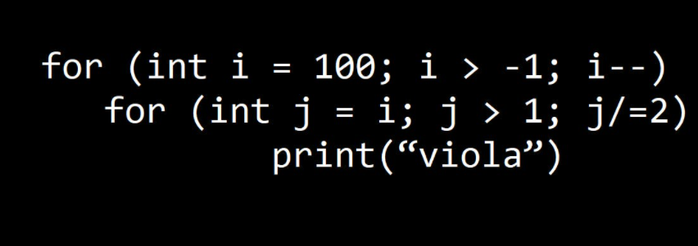
Mentimeter
O(1)
Notes:
Array of Strings

Slide 78
Logarithmic growth
for(i = 1; i <= n; i *= 2)
for(i = n; i >= 1; i /= 2)
https://en.wikipedia.org/wiki/1_%2B_2_%2B_3_%2B_4_%2B_%E2%8B%AF
https://en.wikipedia.org/wiki/1_%2B_2_%2B_4_%2B_8_%2B_%E2%8B%AF
https://en.wikipedia.org/wiki/1/2_%2B_1/4_%2B_1/8_%2B_1/16_%2B_%E2%8B%AF
Notes:
Array of Strings

Slide 79
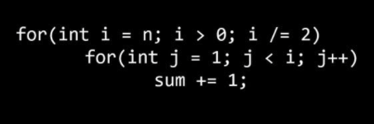
Mentimeter
O(n)
Notes:
Array of Strings

Slide 80
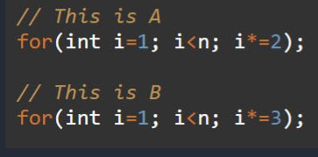
Mentimeter
They both take same time in terms of Big O
Notes:
Array of Strings

Slide 81
Mentimeter
B will be faster in terms of execution time/simulation
Notes:
Array of Strings

Slide 82
Enter Data
Best Case | Average Case | Worst Case
Lowest cost | Average cost for all n | Highest cost
Notes:
But what do we truly care about?

Slide 83
Enter Data
Best Case | Average Case | Worst Case
Lowest cost | Average cost for all n | Highest cost
Average/Best/Worst case measure actual costs at a specific input instance.
You can define a specific order of instance but cannot propose variability in input size.
In general, calculating best case time complexity under the assumption that the data structure has a small size, example: when an array has size 1 or the tree is empty should be avoided. The complexity is calculated without thinking about the size of input. But it is perfectly fine to think about the properties of input or data structure such as data is sorted, height will always be proportional to log n for a balanced tree, etc.
Asymptotic analysis assumes n is very large. Whether it be big O, theta, or omega, it always refers to the case of very large n. The best / average / worst cases arise in different structural cases, exclusive of size.
Growth Rate measures change in costs.
Notes:
But what do we truly care about?

Slide 84
Recommended Readings
https://dev.to/sherryummen/asymptotic-notations-b-oot-big-o-big-omega-big-theta-49e7
Chapter 8.10 OpenDSA: Common Misunderstanding
https://cs.stackexchange.com/questions/23068/how-do-o-and-%CE%A9-relate-to-worst-and-best-case
https://qr.ae/pNyFxo
https://cs.stackexchange.com/questions/23593/is-there-a-system-behind-the-magic-of-algorithm-analysis
https://stackoverflow.com/questions/25593619/why-small-theta-asymtotic-notation-doesnt-exists/54542603

Slide 85
Useful series
1 + 2 + 3 + 4 + ⋯ + n = n.(n+1)/2
1 + 2 + 4 + 8 + ⋯ + 2^{k} = 2^{k+1} – 1
n + n/2 + n/4 + n/8 + ⋯ + 1 = 2n - 1
https://en.wikipedia.org/wiki/1_%2B_2_%2B_3_%2B_4_%2B_%E2%8B%AF
https://en.wikipedia.org/wiki/1_%2B_2_%2B_4_%2B_8_%2B_%E2%8B%AF
https://en.wikipedia.org/wiki/1/2_%2B_1/4_%2B_1/8_%2B_1/16_%2B_%E2%8B%AF
Notes:
Array of Strings

Slide 86
Linear Search
#include <iostream>
#include <string>
std::string linearSearch(const std::string arr[], int size, std::string t)
{
for(int i = 0; i < size; i++)
{
if(arr[i].compare(t) == 0)
return std::string("found at index = ") + std::to_string(i);
}
return std::string("not found");
}
int main()
{
std::string arr[] = {"hello", "world", "cop3530", "cop3502"};
std::string target = "curious";
int size = sizeof(arr) / sizeof(arr[0]);
std::cout << (linearSearch(arr, size, target));
return 0;
}
https://onlinegdb.com/opeGj9PmNm
Notes:
Array of Strings

Slide 87
Linear Search: Assuming a large array
#include <iostream>
#include <string>
std::string linearSearch(const std::string arr[], int size, std::string t)
{
for(int i = 0; i < size; i++)
{
if(arr[i].compare(t) == 0)
return std::string("found at index = ") + std::to_string(i);
}
return std::string("not found");
}
int main()
{
std::string arr[] = {"hello", "world", "cop3530", "cop3502“, ...};
std::string target = "curious";
int size = sizeof(arr) / sizeof(arr[0]);
std::cout << (linearSearch(arr, size, target));
return 0;
}
https://onlinegdb.com/opeGj9PmNm
Notes:
Array of Strings

Slide 88
Linear Search: Assuming a large array
#include <iostream>
#include <string>
std::string linearSearch(const std::string arr[], int size, std::string t)
{
for(int i = 0; i < size; i++)
{
if(arr[i].compare(t) == 0)
return std::string("found at index = ") + std::to_string(i);
}
return std::string("not found");
}
int main()
{
std::string arr[] = {"hello", "world", "cop3530", "cop3502“, ...};
std::string target = "curious";
int size = sizeof(arr) / sizeof(arr[0]);
std::cout << (linearSearch(arr, size, target));
return 0;
}
Size of array = size
Max length of any string = s
Length of target = t
constant
…
https://onlinegdb.com/opeGj9PmNm
Notes:
Array of Strings

Slide 89
Linear Search: Assuming a large array
#include <iostream>
#include <string>
std::string linearSearch(const std::string arr[], int size, std::string t)
{
for(int i = 0; i < size; i++)
{
if(arr[i].compare(t) == 0)
return std::string("found at index = ") + std::to_string(i);
}
return std::string("not found");
}
int main()
{
std::string arr[] = {"hello", "world", "cop3530", "cop3502“, ...};
std::string target = "curious";
int size = sizeof(arr) / sizeof(arr[0]);
std::cout << (linearSearch(arr, size, target));
return 0;
}
linear and dependent on size
linear and dependent on min(t, s)
constant
constant
Size of array = size
Max length of any string = s
Length of target = t
constant
…
https://onlinegdb.com/opeGj9PmNm
Notes:
Array of Strings

Slide 90
Linear Search: Assuming a large array
#include <iostream>
#include <string>
std::string linearSearch(const std::string arr[], int size, std::string t)
{
for(int i = 0; i < size; i++)
{
if(arr[i].compare(t) == 0)
return std::string("found at index = ") + std::to_string(i);
}
return std::string("not found");
}
int main()
{
std::string arr[] = {"hello", "world", "cop3530", "cop3502“, ...};
std::string target = "curious";
int size = sizeof(arr) / sizeof(arr[0]);
std::cout << (linearSearch(arr, size, target));
return 0;
}
(size * min(t, s)) + c
linear and dependent on size
linear and dependent on min(t, s)
constant
constant
Size of array = size
Max length of any string = s
Length of target = t
constant
O (size*t), where size is size of array, t is size of target string, s is the max length of all strings in the array, and we are assuming that t and s grow at same rates.
(size * min(t, s)) + c
https://onlinegdb.com/opeGj9PmNm
Notes:
Array of Strings

Slide 91
Linear Search: Assuming a large array
#include <iostream>
#include <string>
std::string linearSearch(const std::string arr[], int size, std::string t)
{
for(int i = 0; i < size; i++)
{
if(arr[i].compare(t) == 0)
return std::string("found at index = ") + std::to_string(i);
}
return std::string("not found");
}
int main()
{
std::string arr[] = {"hello", "world", "cop3530", "cop3502“, ...};
std::string target = "curious";
int size = sizeof(arr) / sizeof(arr[0]);
std::cout << (linearSearch(arr, size, target));
return 0;
}
Clarification:
This program will yield an equation,
T(size, t) = (size * min(t, s)) + Xc
This function T(size, t) will be an element of O(size.t), O(size.t.t), O(size.size.t), … and several other functions.
When we talk about Big O, we want a measure to describe the upper bound. For the sake of the course, we seek the tightest upper bound.
O (size*t), where size is size of array, t is size of target string, s is the max length of all strings in the array, and we are assuming that t and s grow at same rates.
https://onlinegdb.com/opeGj9PmNm
Notes:
Array of Strings

Slide 92
Linear Search: Assuming a large array
#include <iostream>
#include <string>
std::string linearSearch(const std::string arr[], int size, std::string t)
{
for(int i = 0; i < size; i++)
{
if(arr[i].compare(t) == 0)
return std::string("found at index = ") + std::to_string(i);
}
return std::string("not found");
}
int main()
{
std::string arr[] = {"hello", "world", "cop3530", "cop3502“, ...};
std::string target = "curious";
int size = sizeof(arr) / sizeof(arr[0]);
std::cout << (linearSearch(arr, size, target));
return 0;
}
Clarification:
This program will yield an equation,
T(size, t) = (size * min(t, s)) + Xc
This function T(size, t) will be an element of Ω(size.t), Ω(size), Ω(t), Ω(1) … and several other functions.
When we talk about Big Ω, we want a measure to describe the lower bound. For the sake of the course, we seek the tightest lower bound.
O (size*t), where size is size of array, t is size of target string, s is the max length of all strings in the array, and we are assuming that t and s grow at same rates.
https://onlinegdb.com/opeGj9PmNm
Notes:
Array of Strings

Slide 93
Linear Search: Assuming a large array
#include <iostream>
#include <string>
std::string linearSearch(const std::string arr[], int size, std::string t)
{
for(int i = 0; i < size; i++)
{
if(arr[i].compare(t) == 0)
return std::string("found at index = ") + std::to_string(i);
}
return std::string("not found");
}
int main()
{
std::string arr[] = {"hello", "world", "cop3530", "cop3502“, ...};
std::string target = "curious";
int size = sizeof(arr) / sizeof(arr[0]);
std::cout << (linearSearch(arr, size, target));
return 0;
}
Clarification:
This program will yield an equation,
T(size, t) = (size * min(t, s)) + Xc
In this program, the time complexity of the code is
O(size.t)
Ω(size.t)
Θ(size.t)
O (size*t), where size is size of array, t is size of target string, s is the max length of all strings in the array, and we are assuming that t and s grow at same rates.
https://onlinegdb.com/opeGj9PmNm
Notes:
Array of Strings

Slide 94
String Palindrome

Slide 95
String Palindrome
01 02 03 04 05 06 07 08 09
bool checkPalindrome(string s) { if(s.length() < 2) return true; if(s.at(0) == s.at(s.length()-1)) return checkPalindrome(s.substr(1, s.length()-2)); return false; }

Slide 96
Peak Finding
Input:
You are given an array of numbers
The data is randomly sorted
Output:
A Peak value
Peak is a number such that it is greater than or equal to both of its adjacent elements
In case of the boundary values, a peak must be greater than or equal to the one adjacent element.
Notes:
Space: O1, Time n2

Slide 97
Peak Finding: Case 1
16 | 5 | 32 | 0 | 8
Notes:
Space: O1, Time n2

Slide 98
Peak Finding: Case 1
16 | 5 | 32 | 0 | 8
Case 1: Central Element larger than both adjacent elements:
Notes:
Space: O1, Time n2

Slide 99
Peak Finding: Case 1
16 | 5 | 32 | 0 | 8
Case 1: Central Element larger than both adjacent elements: Peak
Notes:
Space: O1, Time n2

Slide 100
Peak Finding: Case 2
16 | 5 | 8 | 16 | 8
Notes:
Space: O1, Time n2

Slide 101
Peak Finding: Case 2
16 | 5 | 8 | 16 | 8
Case 2: Central Element larger than left element and smaller than right element:
Notes:
Space: O1, Time n2

Slide 102
Peak Finding: Case 2
16 | 5 | 8 | 16 | 8
Case 2: Central Element larger than left element and smaller than right element: Keep going right
Notes:
Space: O1, Time n2

Slide 103
Peak Finding: Case 3
16 | 10 | 8 | 2 | 8
Notes:
Space: O1, Time n2

Slide 104
Peak Finding: Case 3
16 | 10 | 8 | 2 | 8
Case 3: Central Element larger than right element and smaller than left element:
Notes:
Space: O1, Time n2

Slide 105
Peak Finding: Case 3
16 | 10 | 8 | 2 | 8
Case 3: Central Element larger than right element and smaller than left element: Keep going left
Notes:
Space: O1, Time n2

Slide 106
Peak Finding: Case 4
16 | 10 | 8 | 17 | 8
Notes:
Space: O1, Time n2

Slide 107
Peak Finding: Case 4
16 | 10 | 8 | 17 | 8
Case 4: Central Element smaller than both adjacent elements:
Notes:
Space: O1, Time n2

Slide 108
Peak Finding: Case 4
16 | 10 | 8 | 17 | 8
Case 4: Central Element smaller than both adjacent elements: Pick any side and keep going
Notes:
Space: O1, Time n2

Slide 109
Peak Finding
16 | 10 | 8 | 17 | 8
Time Complexity:
O(log₂ n) using the divide and conquer approach over O(n) using brute force algorithms
One Solution: https://onlinegdb.com/YcfKNYnkT0
Notes:
https://onlinegdb.com/4_43yqxfzx

Slide 110
Binary Search
int binarySearch(int arr[], int size, int target)
{
int start = 0, mid, end = size-1;
while(start <= end)
{
mid = (start + end)/2;
if(arr[mid] == target)
return mid;
else if(target > arr[mid])
start = mid + 1;
else
end = mid - 1;
}
return -1;
}
https://onlinegdb.com/S1GzxzljU

Slide 111
Questions
Notes:
Space: O1, Time n2

